Slide 1
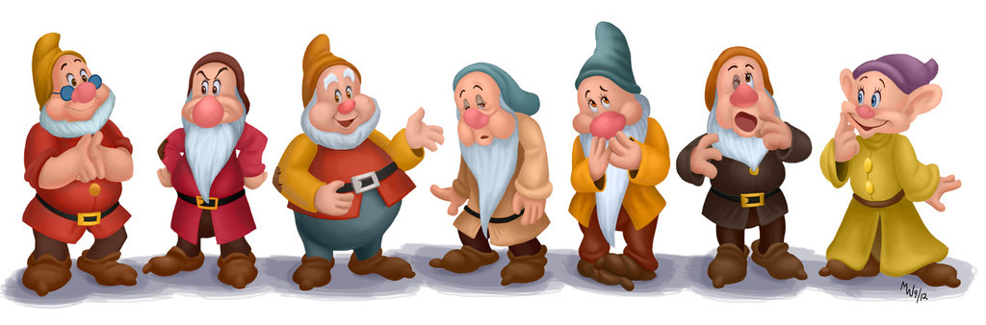
Mathematics Graduates - 2016

Slide 2

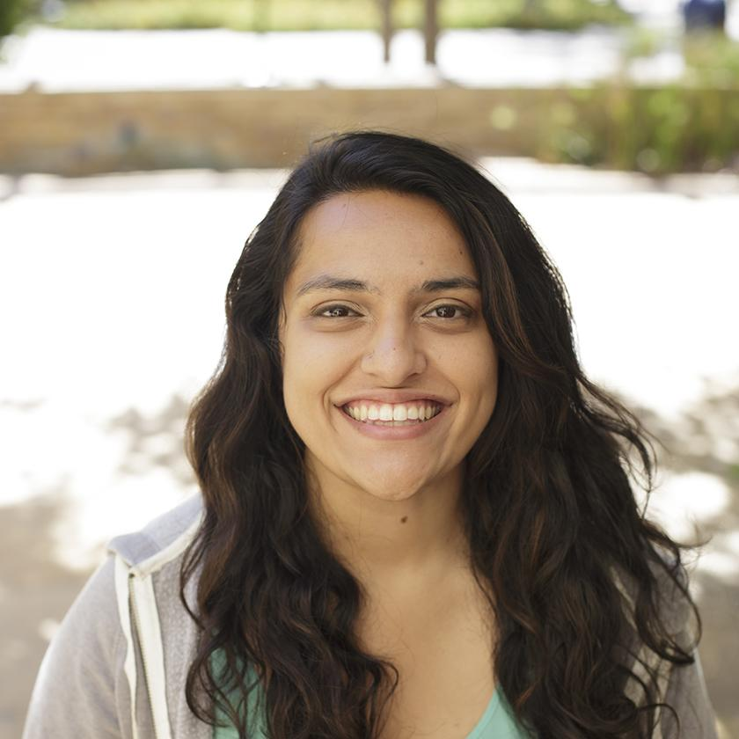
Sara Tandon (Bashful)

Slide 3
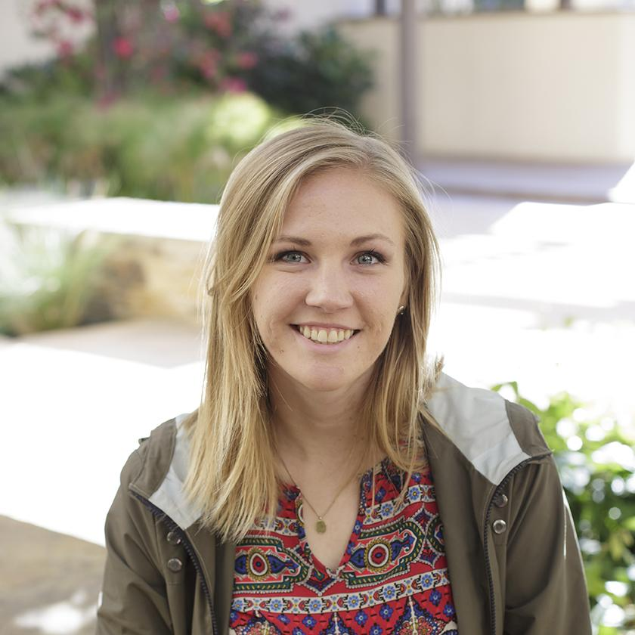
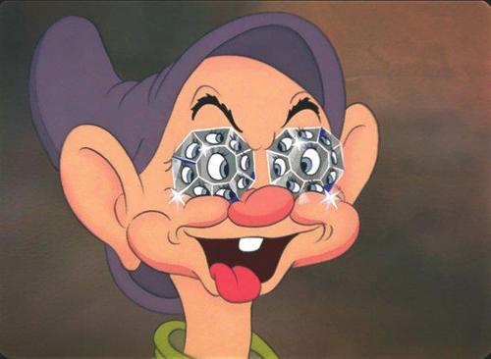
Hanna Kristensen (Dopey)

Slide 4
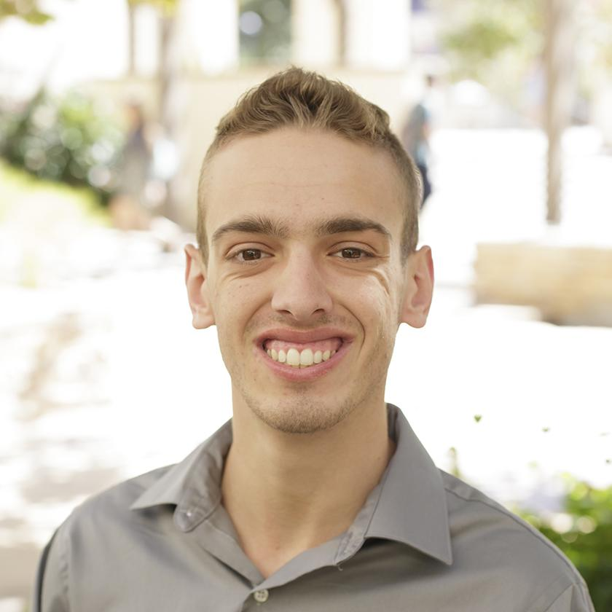

Ben Drozdoff (Sneezy)

Slide 5
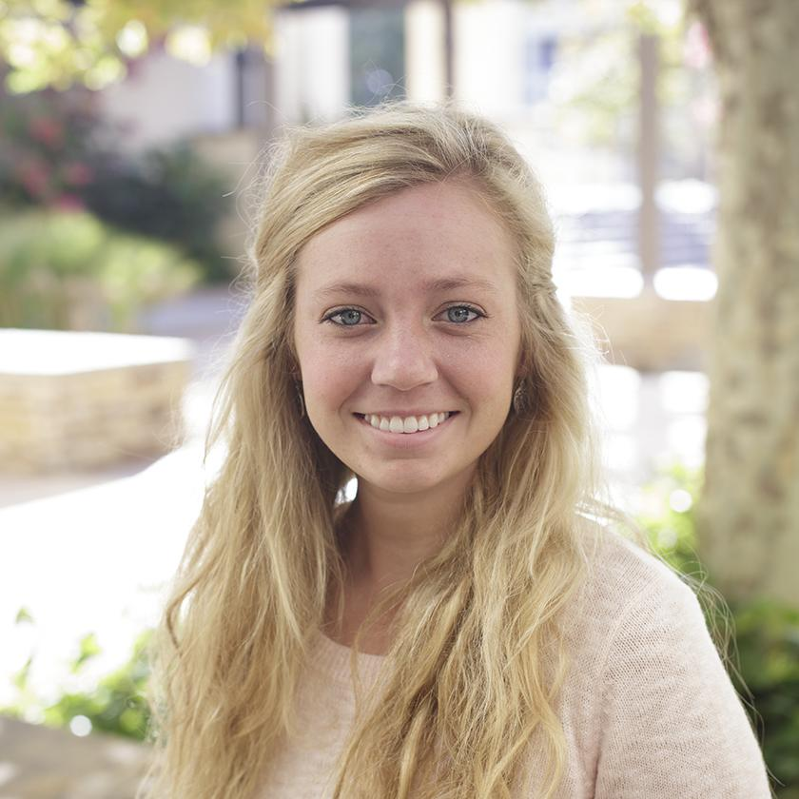
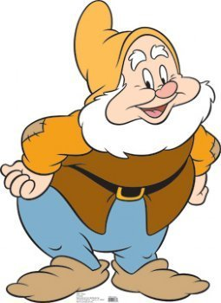
Jordan Weaver (Happy)

Slide 6
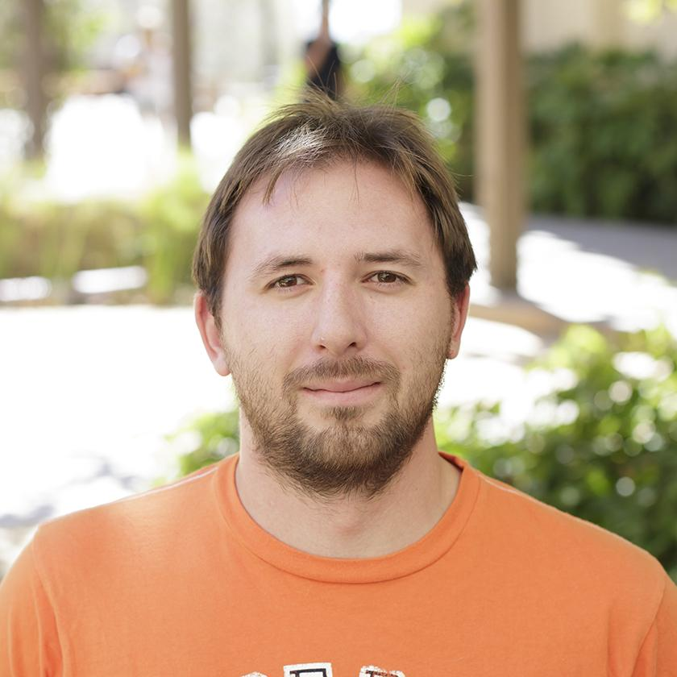
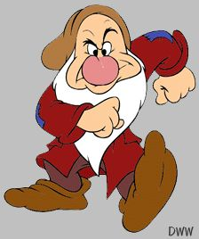
Chris Hallam (Grumpy)

Slide 7
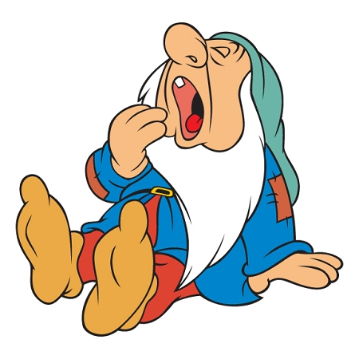
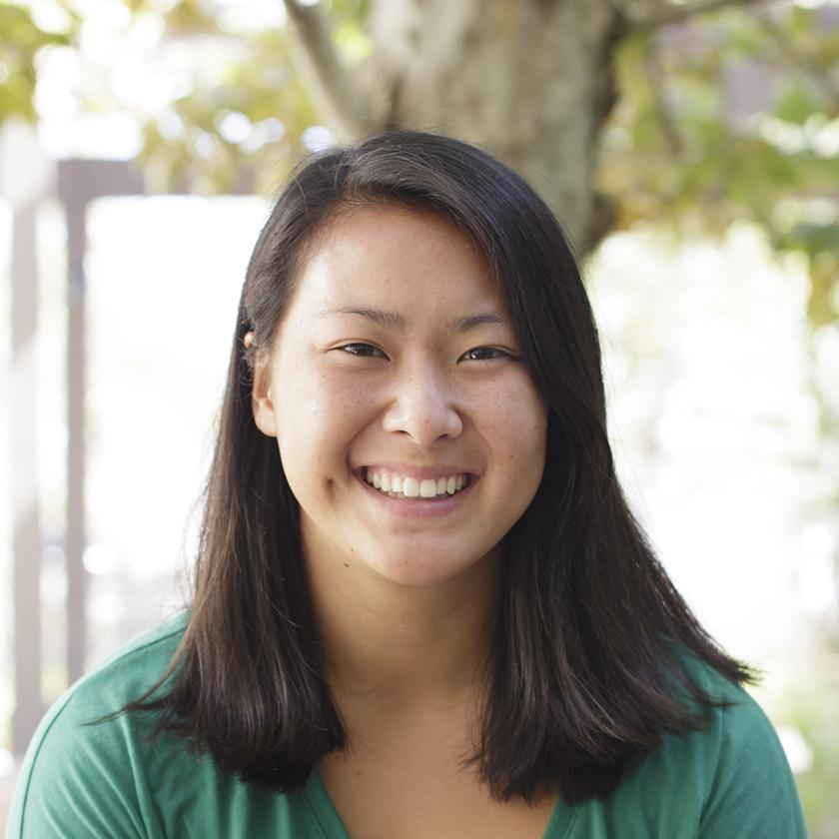
Annie Mitoma (Sleepy)

Slide 8
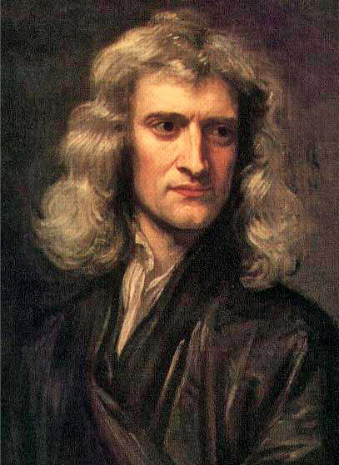
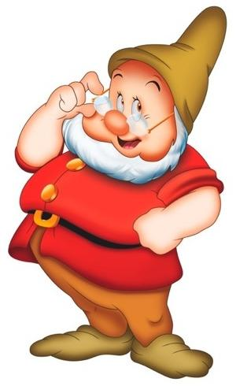
Sir Isaac Newton (Doc)

Slide 9
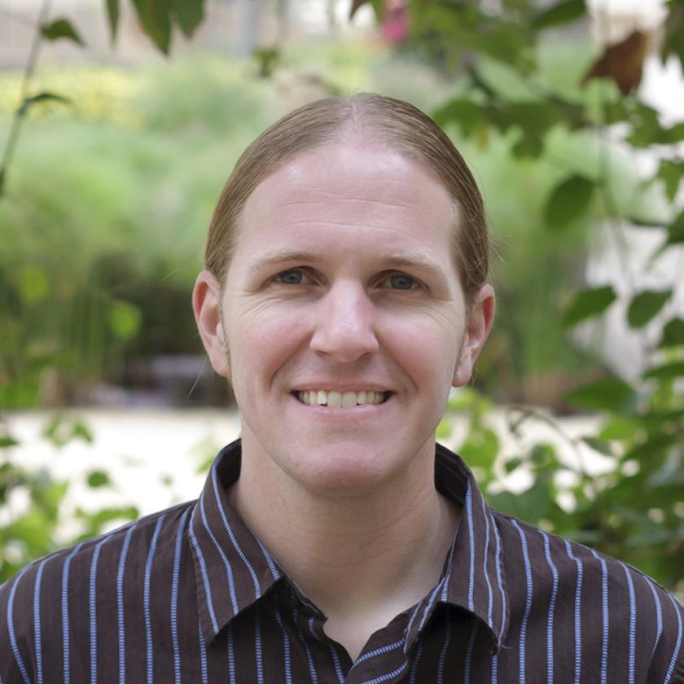
Dr. Lucas (Bashful)

Slide 10
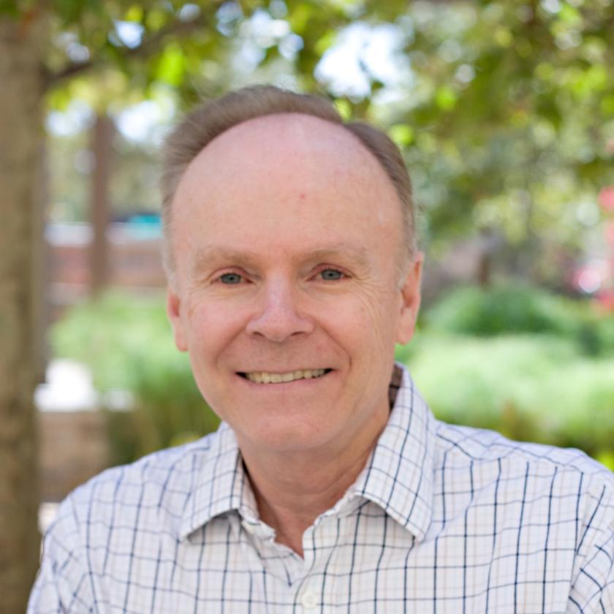
Dr. Hancock (Doc)

Slide 11
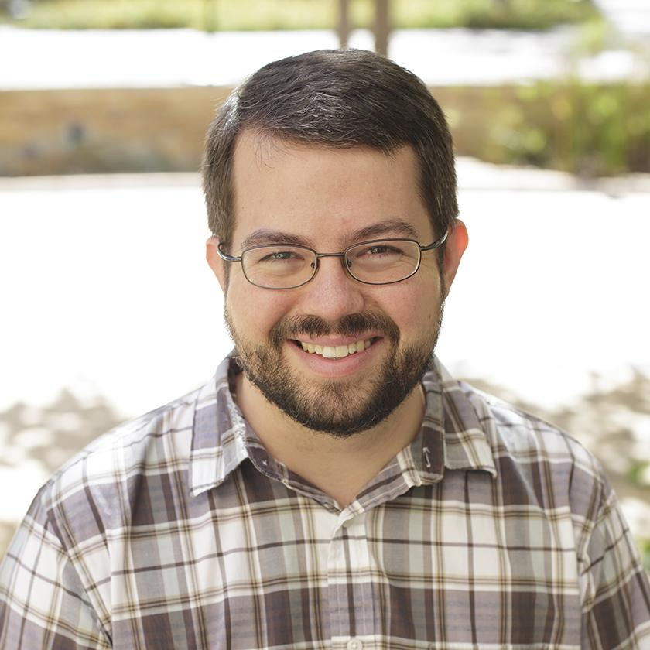
Dr. Bowman (Sleepy)

Slide 12
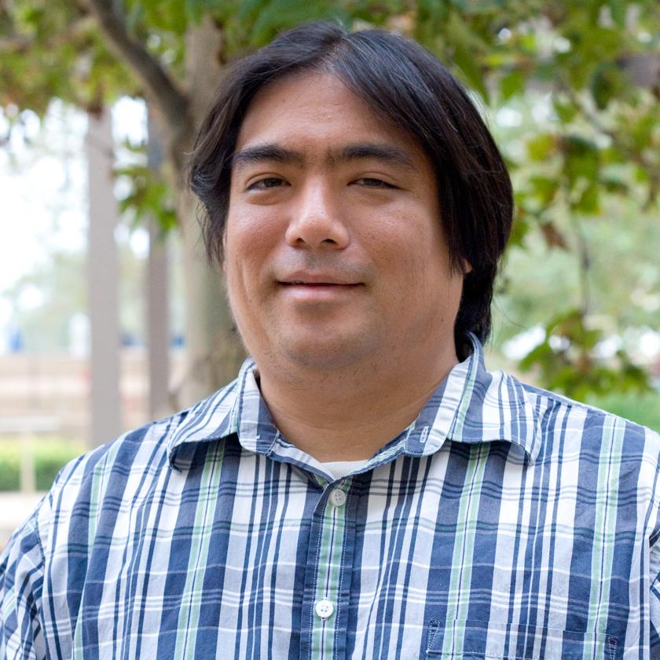
Dr. Iga (Sneezy)

Slide 13
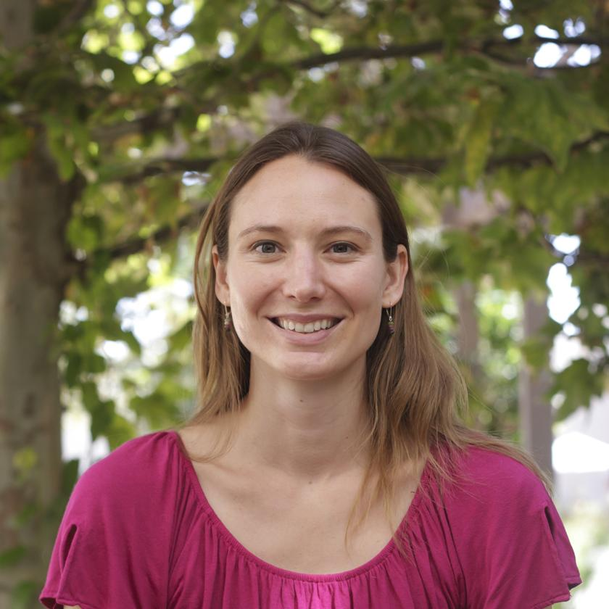
Dr. Davis (Happy)

Slide 14
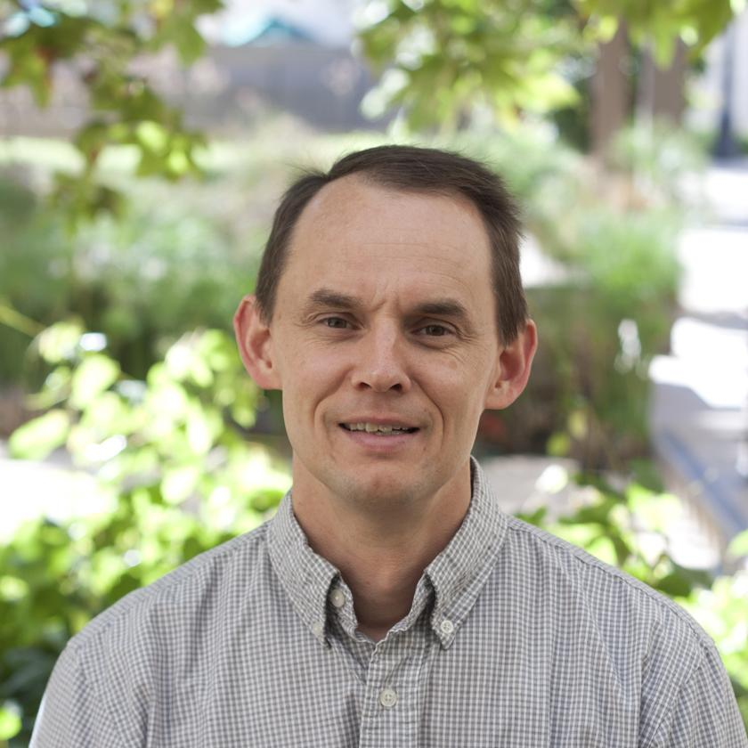
Dr. Strong (Dopey)

Slide 15
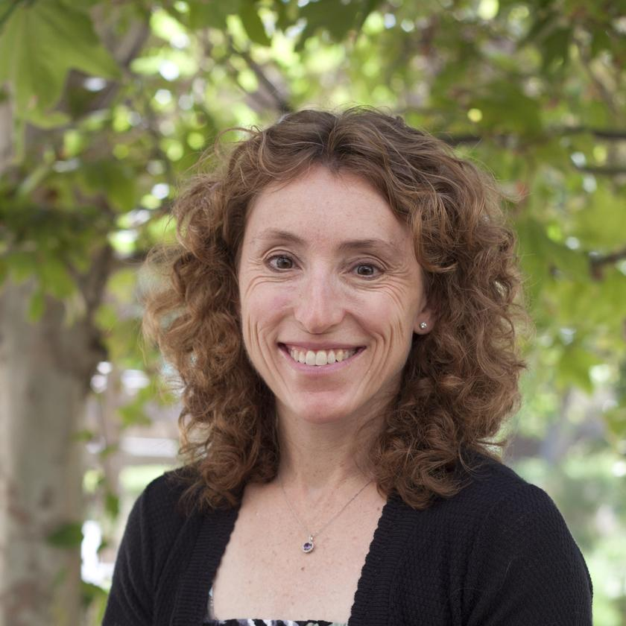
Dr. Killpatrick (Grumpy)

Slide 16
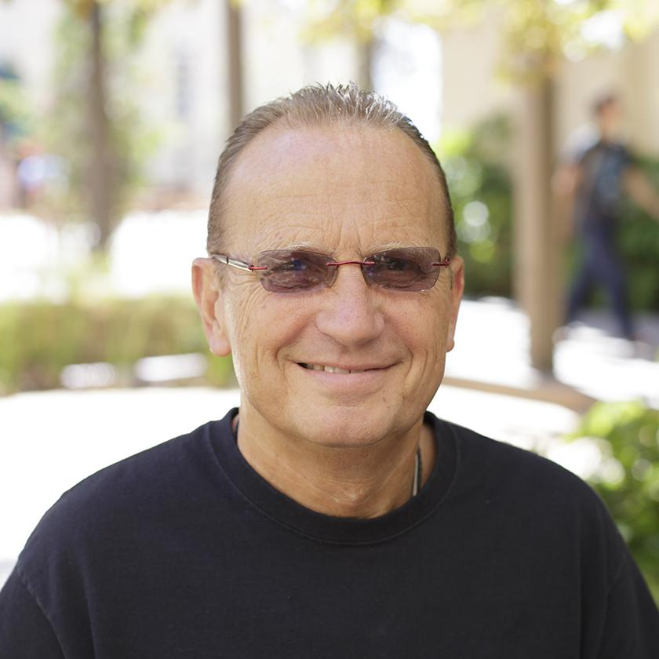
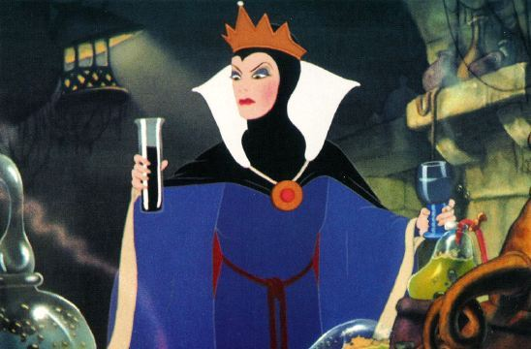
d.t. (The Evil Queen)

Slide 17
Final Exam - 2016 Graduating Class
Chris, who will fix our parking tickets now?
Ben, how about box seats to the Rays/Angels games on May 6, 7 AND 8?
Jordan, do you have an umbrella? Does your raincoat have gills?
Sara, can you leave us a recording of your laugh? It will brighten up the next Real Analysis Final.
Annie, can we get a discount on DISH Network?
Hanna, do you want to take your RAC lobby couch? It’s YOURS!
Isaac, where would we be without you?

